Slide 1
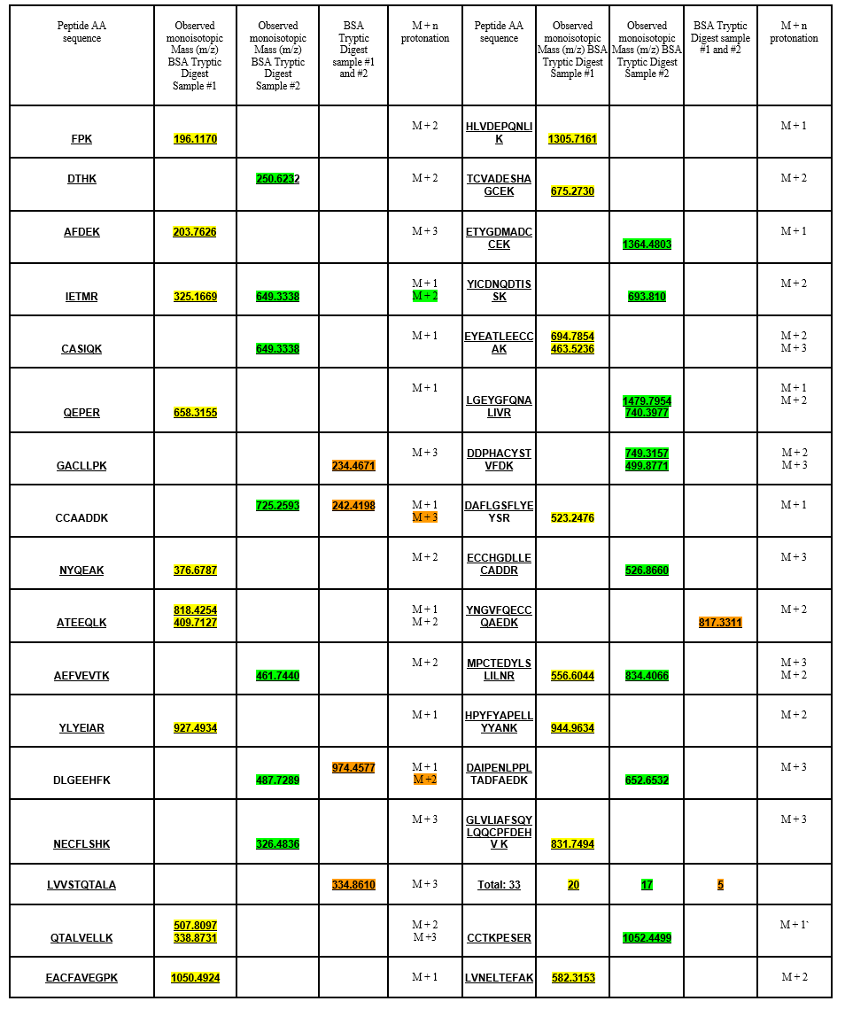
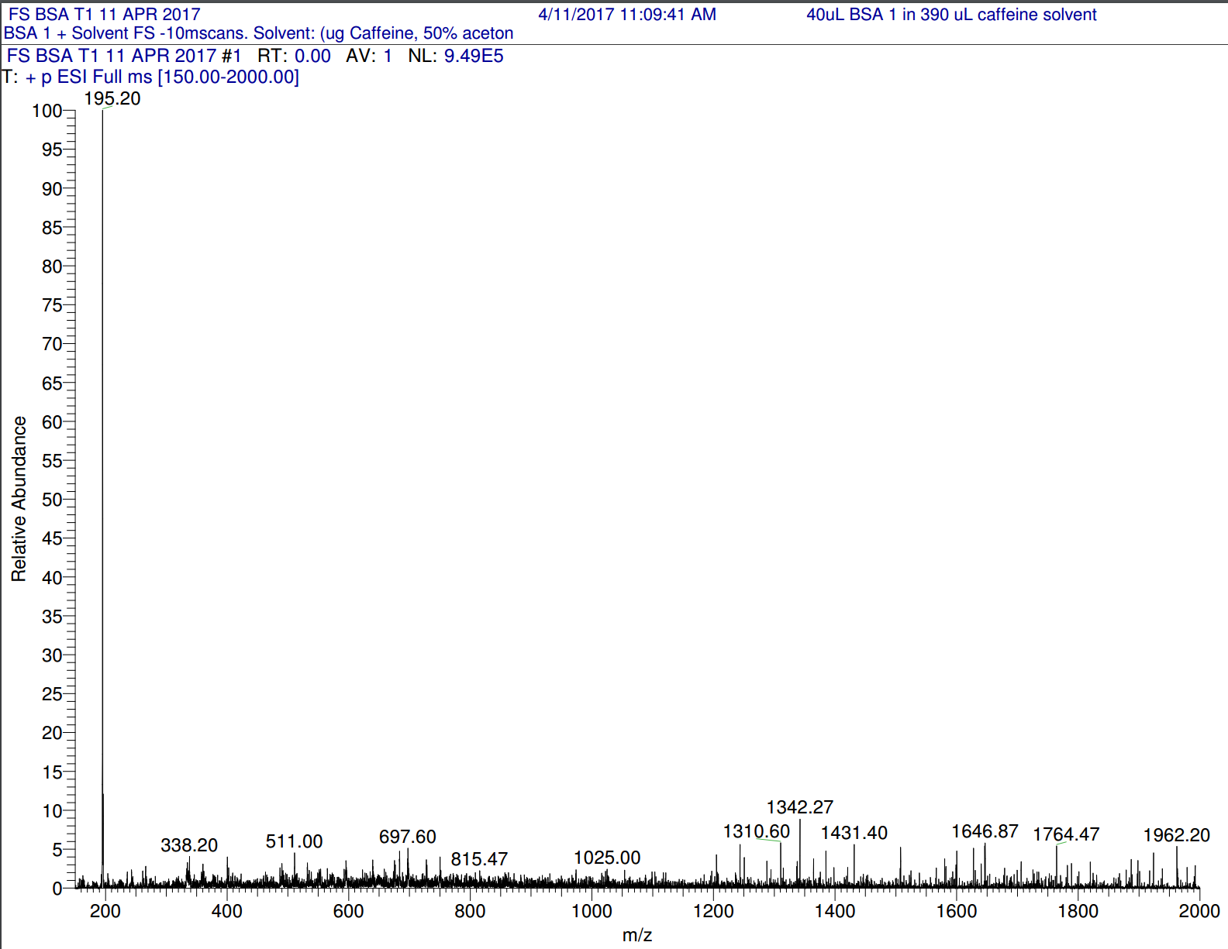
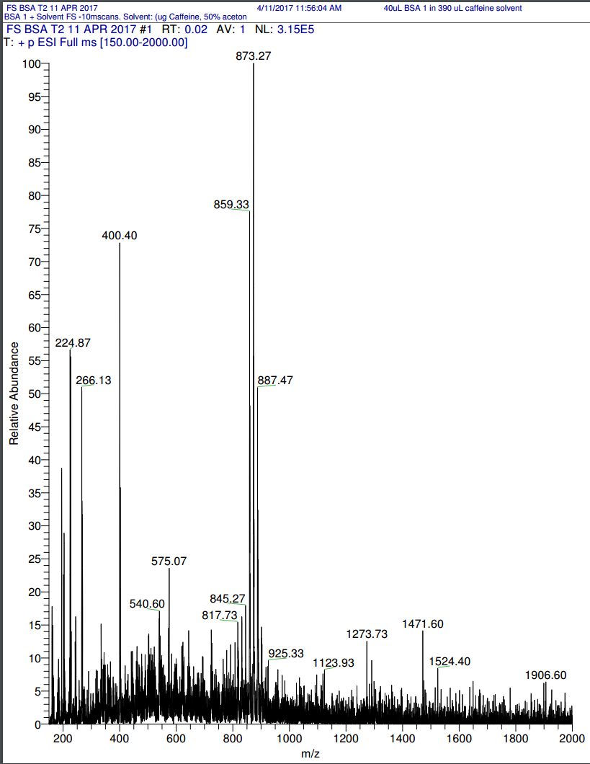
Assessing low cost tryptic digest for high quality mass spectral analysis
Daisia C. Frank and Marcia M. Schilling, PhD
Austin Peay State University
s
Abstract
Proteomics is a multistep process used to identify proteins that are differentially expressed in closely related samples. In order to determine the most cost effective approach to tryptic digestion of proteins, a manufacturer’s tryptic digestion kit was compared to using chemicals purchased from alternative sources. Results indicated that excess reagents from the manufacturer’s kit could be coupled with trypsin/EDTA solution used for cell culture when the limited purified trypsin was exhausted from the kit. Furthermore, all reagents could be purchased in bulk, provided contamination could be minimized over time.
Methodology
Tryptic Digestion: 15 µl digestion buffer and 1.5 µl reducing buffer added to 0.5 mL microcentrifuge tube. Extracted 9.25 µg band from EZ ?? gel protein band #43 (Bovine Albumin) and 17.75 µl ultrapure water to tube. Incubated sample at 95℃ for five minutes then cooled. 3.2 µl of Alkylation Buffer added to tube and incubated in dark room for 21 minutes. 1.23 µl Activated Trypsin (from kit) added to reaction tube and incubated at 39℃ for 3 hours. An Additional 1 µl of Activated Trypsin is added to the tube and incubated at 30℃ overnight.
Peptide Enrichment: Peptides in the digestion mixture were purified using C18 spin columns manufactured by Pierce #89870. The peptides from Bovine albumin that have now been digested were placed in a C-18 spin column and centrifuged for about thirty seconds at 1500 RPM. The flow through was discarded and the column was rinsed with methanol, TFA, and ACN, and lastly eluted with 70% ACN.
Mass Spectrometer:
In order to provide consistent and accurate data a spectral profile from Thermo-Fisher Calibration solution is used to determine readiness of the mass spectrometer before collecting experimental data. The calibration spectrum shows a reasonable amount of contamination. A control solution consisting of 50% acetonitrile, 25% methanol, 24% water, 1% trifluoracetic acid (TFA)was used to account for any contamination within the instrument or in the solutions, and any peaks that arise from other chemicals.
.
Introduction
Trypsin is a serine protease, which is an enzyme that cleaves the peptide bonds in proteins. Trypsin cleaves peptide chains mainly at the carboxyl side of the amino acids lysine or arginine. Tryptic digestion can be used to identify unknown proteins alongside using mass spectrometry analysis. The goal of this research was to determine the most cost-effective method of performing a trypsin digest. Trypsin-EDTA from the Thermo-Scientific In-Solution Tryptic Digestion Kit and individually purchased Fisher-Price Trypsin-EDTA were used separately in two different digestions then analyzed using the mass spectrometer to confirm the protein’s identity. Mass spectrometry works by protonating molecules in order to identify their mass to charge ratio (m/z). Bovine Albumin (BSA) was implemented in both samples as the sample molecule (Protein Band #43). This experiment will be successful if both spectra match the BSA Protein Digest Standard.
Results
Table 1: Sample #1 (Trypsin-EDTA in kit) and Sample #2 (Trypsin-EDTA separate and each of the peptide fragments with the corresponding peaks for Bovine Albumin.
Acknowledgements
I would like to thank Dr. Marcia M. Schilling for her support in my undergraduate research, Dr. Leslie Hiatt and Nick Roberts for their insightful information regarding mass spectrometry, and the Department of Chemistry faculty at Austin Peay State University for serving as mentors in my scientific development.
Discussion
The first tryptic digest didn’t have very good peaks at all. This was due to having to wait to analyze the sample because of complications with the mass spectrometer. However, about 20 corresponding peaks indicated that the protein was Bovine Albumin. The second sample which contained the Trypsin-EDTA purchased separately had much more clear and distinct peaks because analysis was performed directly after elution. However, only about 17 corresponding peaks we’re identified. Table 1 shows the two samples and each of the peptide fragments with the corresponding peaks for Bovine Albumin.
References
Baldwin M. 2004. Protein identification by mass spectrometry. American Society for Biochemistry and Molecular Biology. 10.1074.
Figure 1: Bovine Albumin Trypsin Digest with Thermo-Scientific kit (left) and Thermo-Scientific purchased separately.

